Slide 1
AZ-900T0x Module 04: Azure pricing and support
Notes:
Adjust the cover for either AZ-900T00 or AZ-900T01.

Slide 2
Lesson 01: Learning objectives

Slide 3
Module 4 – Learning objectives
Understand and describe Microsoft Azure subscriptions and management groups.
Recognize ways to plan and manage Azure costs.
Understand Azure support options.
Understand and describe features of Azure Service Level Agreements (SLAs).
Understand and describe the service lifecycle in Azure.

Slide 4
Lesson 02: Azure subscriptions

Slide 5
Azure subscriptions
An Azure subscription provides you with authenticated and authorized access to Azure accounts.
Subscriptions can provide billing and access control boundaries.
An account can have one subscription or multiple subscriptions.
Notes:
Azure subscription offers - https://azure.microsoft.com/en-us/support/legal/offer-details/

Slide 6
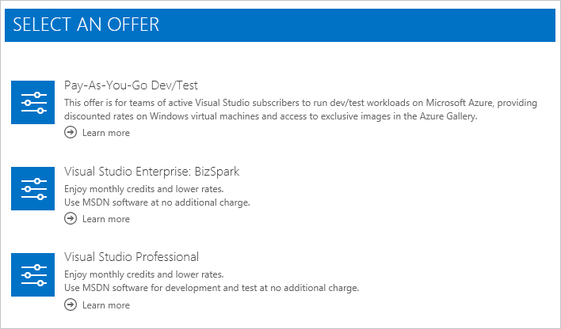
Subscription offers
Free (next slide)
Pay-as-you-go
Enterprise Agreement
Student
An account can have one subscription or multiple subscriptions.
Notes:
Azure subscription offers - https://azure.microsoft.com/en-us/support/legal/offer-details/

Slide 7
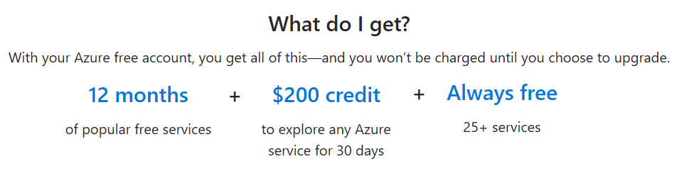
Azure free account
Provides 12 months of our most popular services, a $200 credit to explore any Azure service for 30 days, and over 25 services are free.
At the end of the trial you can upgrade to pay-as-you-go pricing.
Notes:
Azure free accounts - https://azure.microsoft.com/en-us/free/

Slide 8
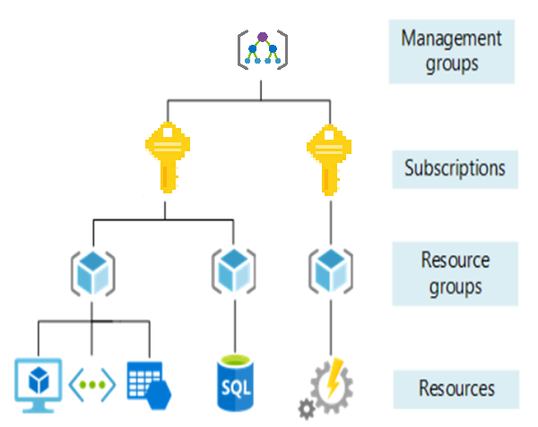
Management Groups
Management groups can include multiple Azure subscriptions.
Subscriptions inherit conditions applied to the management group.
10,000 management groups can be supported in a single directory.
A management group tree can support up to six levels of depth.
Notes:
Management groups - https://docs.microsoft.com/en-us/azure/governance/management-groups/

Slide 9
Lesson 03: Planning and managing costs

Slide 10
Purchasing Azure products and services
Three main customer types on which the available purchasing options for Azure products and services are contingent are:
Enterprise: Enterprise customers sign an Enterprise Agreement with Azure that commits them to spending a negotiated amount on Azure services, which they typically pay annually.
Web direct: Web direct customers sign up for Azure through the Azure website.
Cloud solution providers (CSPs): Typically are Microsoft partner companies that a customer hires to build solutions on top of Azure. Payment and billing for Azure usage occurs through the customer's CSP.
Notes:
Azure products and services purchasing options - https://azure.microsoft.com/en-us/pricing/purchase-options/

Slide 11
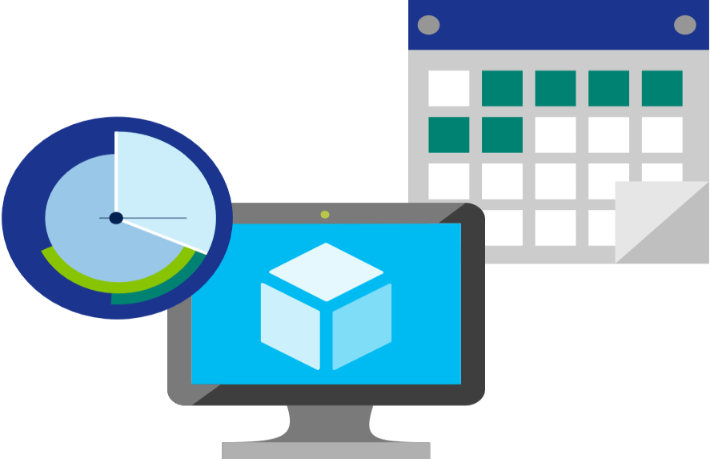
Factors affecting costs
There are three primary factors affecting costs:
Resource Type: Costs are resource-specific, so the usage that a meter tracks and the number of meters associated with a resource depend on the resource type.
Services: Azure usage rates and billing periods can differ between Enterprise, Web Direct, and CSP customers.
Location: The Azure infrastructure is globally distributed, and usage costs might vary between locations that offer Azure products, services, and resources.
Notes:
Azure usage charges - https://docs.microsoft.com/en-us/azure/billing/billing-understand-your-invoice

Slide 12

Zones for Billing Purposes
Bandwidth refers to data moving in and out of Azure datacenters. Some inbound data transfers are free, such as data going into Azure datacenters. For outbound data transfers—such as data going out of Azure datacenters—pricing is based on Zones.
Zone 1 - West US, East US, West Europe, and others.
Zone 2 - Australia Central, Japan West, Central India, and others.
Zone 3. - Brazil South only.
DE Zone 1- Includes Germany Central and Germany Northeast.
Notes:
Point out that the Zone referred to here, is different from Availability Zone. Availability Zones being an Azure service providing High availability, whereas Zones in the context of billing are geographical entities, used for data transfer pricing between defined geographical areas called Zones.
Zone is a geographical grouping of Azure Regions for billing purpose. Data transfer pricing is based on the Zones.

Slide 13
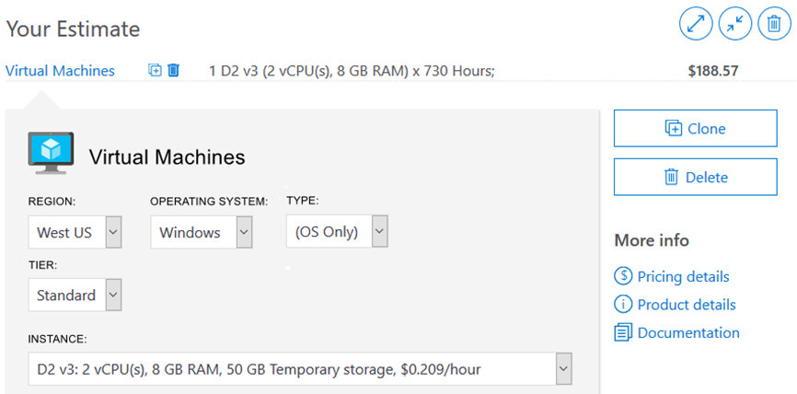
Pricing calculator
Provides a detailed estimate of the costs associated with your infrastructure configuration.
Notes:
Note: The pricing calculator provides estimates, and not actual price quotes. Actual prices can vary depending upon the date of purchase, the payment currency, and the type of Azure customer.

Slide 14
Walkthrough - Use the Azure Pricing Calculator
Use the Azure Pricing Calculator to generate a cost estimate for an Azure virtual machine and related network resources.
Configure the pricing calculator.
Review the pricing estimate.
Notes:
You can use this as a demonstration, have the students step through the tasks together, or have the students try it themselves.

Slide 15
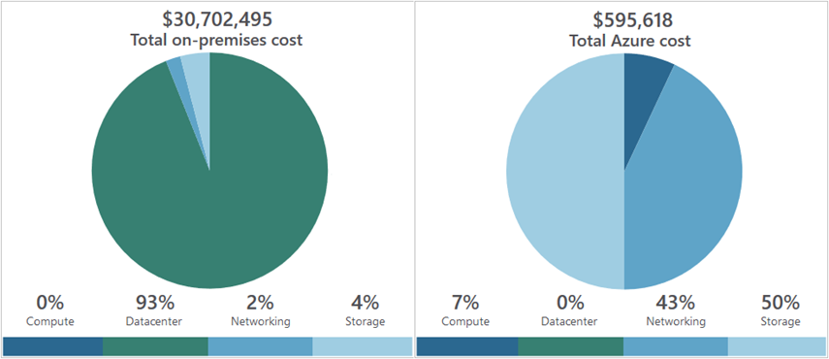
Total cost of ownership calculator
A tool to estimate cost savings you can realize by migrating to Azure.
A report compares the costs of on-premises infrastructures with the costs of using Azure products and services in the cloud.
Notes:
TCO calculator - https://azure.microsoft.com/en-us/pricing/tco/calculator/

Slide 16
Walkthrough - Use the Azure TCO Calculator
Use the Total Cost of Ownership (TCO) Calculator to generate cost comparison report for an on-premises environment.
Configure the TCO calculator.
Review the results and save a copy.
Notes:
You can use this as a demonstration, have the students step through the tasks together, or have the students try it themselves.

Slide 17
Minimizing costs
Perform
Perform cost analyses. Use the Azure Pricing and TCO calculators.
Monitor
Monitor usage with Azure Advisor. Implement recommendations.
Use
Use spending limits. Use via free trial customers and some credit-based Azure subscriptions.
Use
Use Azure Reservations and Azure Hybrid Benefit (HUB).
Choose
Choose low-cost locations and regions. If possible, use low-cost locations.
Keep
Keep up-to-date with the latest Azure customer and subscription offers.
Apply
Apply tags to identify cost owners. Identify usage owners with tags.

Slide 18
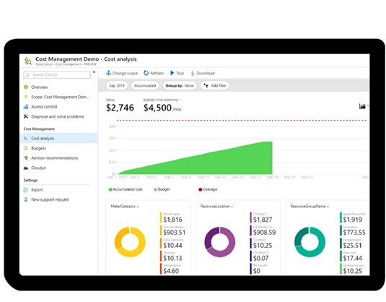
Azure Cost Management
Reporting
Data enrichment
Budgets
Alerting
Recommendations
Notes:
Note: For more information about Cost Management, refer to https://azure.microsoft.com/en-us/services/cost-management/

Slide 19
Lesson 04: Azure support options

Slide 20
Support plan options
Every Azure subscription includes free access to billing and subscription support, Azure products and services documentation, online self-help documentation, white papers, and community support forums.
 | Basic | Developer | Standard | Professional Direct
Scope | Available to all Microsoft Azure accounts | Trial and non-production environments | Production workload environments | Business-critical dependence
Technical Support |  | Business hours access to Support Engineers via email | 24x7 access to Support Engineers via email and phone | 24x7 access to Support Engineers via email and phone
Notes:
For more information about Azure support options, refer to https://azure.microsoft.com/en-us/support/plans/

Slide 21





Alternative support channels
Microsoft Developer Network (MSDN) Azure Forums
Stack Overflow
Server Fault
Microsoft Azure general feedback
@AzureSupport
Notes:
For more information about alternative Azure support channels, refer to https://azure.microsoft.com/en-us/support/community/

Slide 22
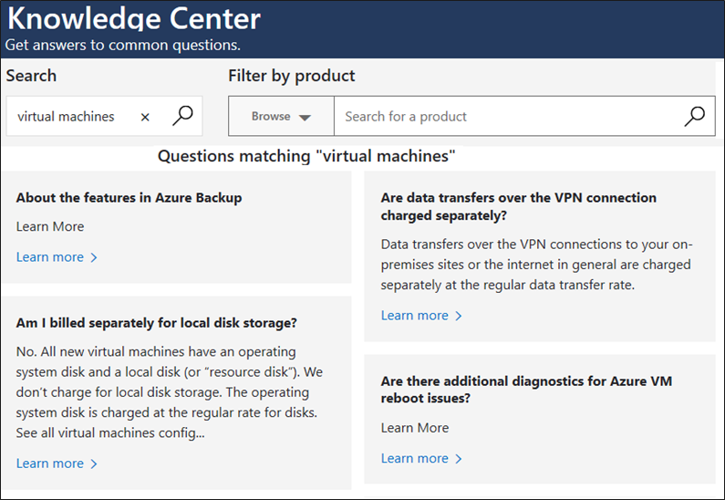
Knowledge Center
A searchable database that contains support questions and answers from a community of Azure experts, developers, customers, and users.
Notes:
For more information about alternative Knowledge Center, refer to https://azure.microsoft.com/en-us/resources/knowledge-center/

Slide 23
Walkthrough - Open a Support Request
View available support plan options and then practice creating and monitoring a new support request.
View available support plan options and create a new technical support request.
Create a billing support request.

Slide 24
Lesson 05: Azure Service Level Agreements (SLAs)

Slide 25
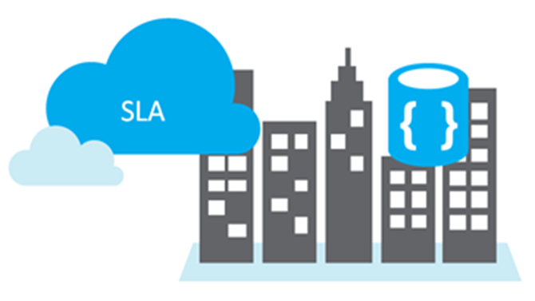
Service Level Agreements (SLAs)
SLAs document the specific terms that define Azure performance standards.
SLAs define Microsoft’s commitment to an Azure service or product.
Individual SLAs are available for each Azure product and service.
SLAs also define what happens if a service or product fails to meet the designated availability commitments.

Slide 26
SLAs for Azure products and services
Performance targets are expressed as uptime and connectivity guarantees.
Performance-targets range from 99.9% (three nines) to 99.99% (four nines).
If a service fails to meet the guarantees, a percentage of the monthly service fees can be credited to you.
SLA | Downtime per month | Downtime per year
99.9% | 43.2 minutes | 8.76 hours
99.95 | 21.6 minutes | 4.38 hours
99.99 | 4.32 minutes | 52.56 minutes
Notes:
You might want to browse to some SLA’s directly https://azure.microsoft.com/en-us/support/legal/sla/summary/ and explore one or two as examples.

Slide 27
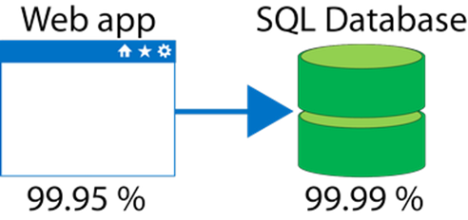
Composite SLAs
If the App Service has a 99.95% SLA, and the Azure SQL Database has a 99.99% SLA, what is the composite SLA for your application?
Notice the composite SLA is lower than the individual SLAs.
Improve the SLA by creating independent fallback paths.
Composite SLA
.9995 * .9999
= 99.94%

Slide 28
Application SLAs
Customers should determine what SLA is needed for their application.
Know your workload requirements and usage patterns.
Design for resiliency and availability.
Establish availability metrics — mean time to recovery (MTTR) and mean time between failures (MTBF).
Establish recovery metrics — recovery time objective and recovery point objective (RPO).
Implement resiliency strategies.
Build in availability requirements.
Notes:
For more information about improving application SLAs, refer to https://docs.microsoft.com/en-us/azure/architecture/resiliency/

Slide 29
Walkthrough - Calculate a Composite SLA
Determine services SLA uptime percentages and then calculate the application composite SLA uptime percentage.
Determine the SLA uptime percentage values for an application.
Calculate the Application Composite SLA percentage uptime.

Slide 30
Lesson 06: Service lifecycle in Azure

Slide 31
Public and private preview features
Microsoft offer previews of Azure features for evaluation purposes.
With Azure previews, you can test beta and other pre-release features, products, services, software, and regions.
Private Preview is an Azure feature available to certain Azure customers for evaluation purposes.
Public Preview is an Azure feature available to all Azure customers for evaluation purposes.
Notes:
Some preview features are not covered by customer support.
For more information about Azure Previews, visit https://azure.microsoft.com/en-us/services/preview/

Slide 32
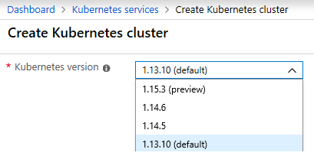
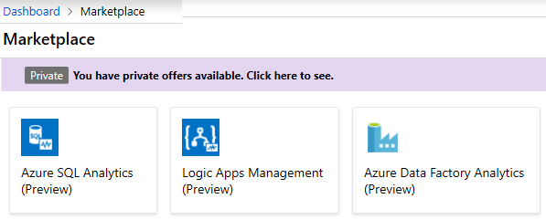
Accessing preview features
Preview new functionality and features for an existing service.
Preview new services.
Notes:
✔️ Although you may be using the Azure service in production, the preview feature or functionality may not yet be ready for production deployments. Make sure you are aware of any limitations around its use before deploying to production.

Slide 33
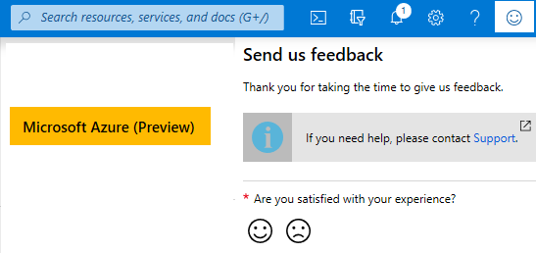
Accessing Azure Portal preview
Access the Azure Portal (Preview) - https://preview.portal.azure.com.
Provide feedback on new features such as full-screen blades, performance, navigation, notifications, and accessibility improvements.
Check out the Azure Portal feedback forum.
Notes:
✔️ Azure Portal feedback forum - https://feedback.azure.com/forums/223579-azure-portal

Slide 34
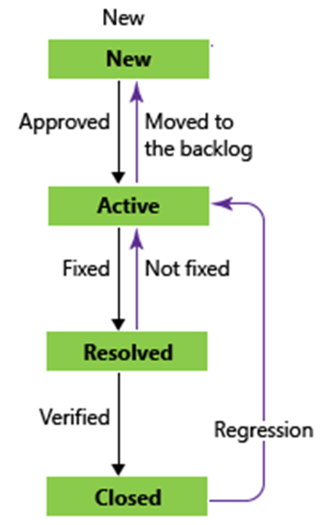
General Availability
New features are evaluated and tested.
Feature bugs go through a lifecycle of new, active, resolved, and fixed.
General availability provides successfully tested features to all Azure customers.
Azure blog announcements is a good source of information.
Notes:
✔️ Learn about updates and new product features on the Azure announcements blog - https://azure.microsoft.com/en-us/blog/topics/announcements/.

Slide 35
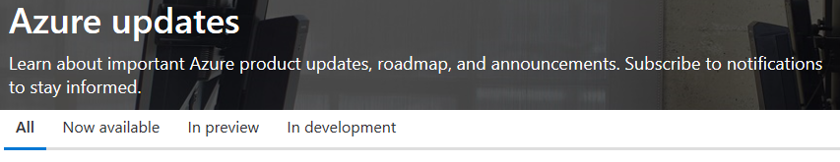
Monitoring service and feature updates
Azure updates provides information about the Azure products, services, and features, and product roadmaps, and availability.
View details about all Azure updates and their status.
Browse and search for updates.
Subscribe to Azure update notifications by RSS.
Notes:
For more information about Azure updates, refer to https://azure.microsoft.com/en-us/updates/

Slide 36
Walkthrough - Access Azure Preview features
Access and identify Azure preview services and features and view the latest Azure updates information.
Access preview services and features.
Review the Azure updates page.

Slide 37
Lesson 07: Module review questions
Notes:
As you have time, cover the module review questions in the student materials.

